Slide 1
COVAX: What is it and Why Is It Important?
Will Humble, MPH
Executive Director,
Arizona Public Health Association

Slide 2
Learning Objectives
Be able to describe the mission of COVAX and the basics of its organizational structure
Learn about health disparities related to COVID19 Vaccine Access
Understand compliance criteria for countries to participate in COVAX
Understand the progress made by COVAX to date at providing vaccine to developing nations
Identify 2 important interventions that would improve COVAX's performance

Slide 3
What is COVAX?
COVAX, an international partnership led by the Coalition for Epidemic Preparedness Innovations (CEPI), Gavi, the Vaccine Alliance, UNICEF, and the World Health Organization
Created to respond to distribute 2 Billion doses of COVID-19 vaccine to developing nations by the end of 2021
COVAX is the only international effort to ensure that people in all countries have access to COVID-19 vaccines
Lower-income nations would otherwise be unable to afford or access COVID-19 vaccines
https://www.who.int/initiatives/act-accelerator/covax

Slide 4
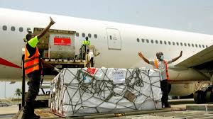
COVAX Mission
Play: 3 Minute Video: COVAX explained

Slide 5
COVAX Governance
Chaired by José Manuel Barroso and composed of 28 members, the Gavi Board is the Vaccine Alliance's governing body

Slide 6
Why is It Needed?
Because it’s the right thing to do!
Wealthy countries have already vaccinated 60% of their adult population
Low-income countries have vaccinated <3% of their population as of October 1
Rich nations can afford and have contracts to vaccinate their entire population
Poorer countries have difficulty affording vaccine
Rich countries have a moral obligation to help low-income countries
The longer it takes for the world to get to herd immunity the more chances the virus will form a variant that escapes immunity from both infection & vaccines
Who wants to learn the word COVID-22?

Slide 7
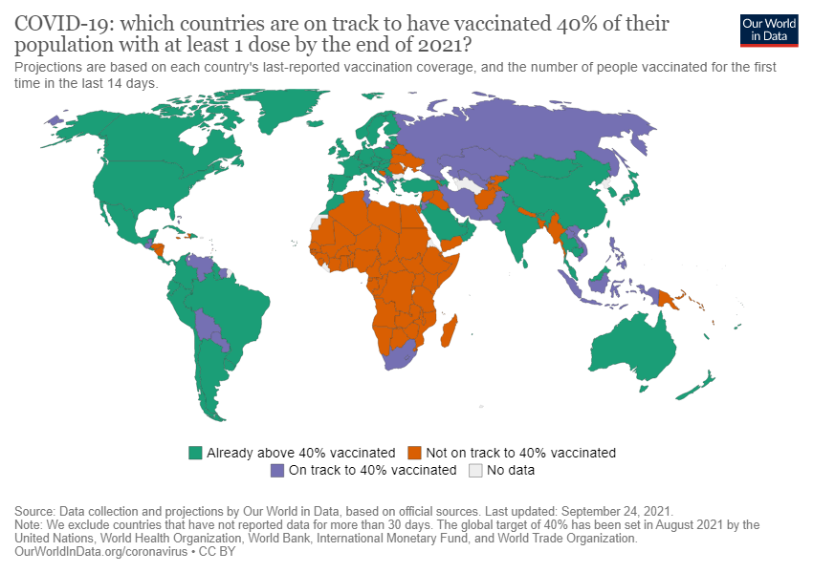

Slide 9
Vaccination Rates In Randomly Selected Countries

Slide 10
Which Countries Can Participate?
Self-Financing (High Income) Countries: Self-financing countries are responsible for paying for their participation in COVAX to have access to the COVAX portfolio. 90 countries have joined COVAX as self-financing
Funded (Low- and Middle-Income) Countries: Low- and middle- income countries are eligible to access vaccines that they would otherwise be unable to afford. Funding is provided by public and private donors

Slide 11
What Are COVAX’ Core Allocation Principles?
To have a set of overarching principles for access to and allocation of health products for COVID-19;
Set a global framework to ensure equitable and fair access and allocation of COVID-19 health products; and
fair and equitable allocation mechanisms for each product stream, developed in collaboration with relevant partners.

Slide 12
What Are COVAX’ Criteria for Compliance?
Accountability. Countries must have clearly defined roles and allocation and distribution responsibilities that ensure procedural justice. Clearly defined objectives, targets, processes, roles, responsibilities and decisions must ensure equitable and fair access to health products.
Transparency. Countries must build and maintain trust with their populations. Transparency of and access to timely, robust and relevant information related to the discovery, development and delivery of health products are required.
Responsiveness to public health needs. Countries must ensure that their procedures and strategies are selected and allocated to address the public health need. COVAX supplies must be used to reduce mortality, reduce morbidity, prevent infection, and facilitate prompt diagnosis and contribute to delivery of optimal care.

Slide 13
What Are COVAX’ Criteria for Compliance?
Affordable and available to the population. Countries must make sure COVAX supplies are affordable, available and appropriate for the individual and setting in which they are used. Ensuring access to COVID-19 health products cannot compromise equitable access to health products and services that are essential for other public health needs.
Equity and fairness. A country’s allocation process must be driven by public health needs. Countries must use equitable and consistent allocation procedures to maximize public health benefits and ensure that scarce health products are available and accessible to those in need. Criteria include epidemiological factors and vulnerabilities, among other aspects.
Affordability. Countries must ensure that pricing and procurement strategies are affordable and equitable. Parient costs may not pose a barrier to access (but sustainability of health systems and manufacturers may be safeguarded)

Slide 14
Who is Participating & What Are They Buying?
Ninety-two low & middle-income economies are eligible to participate in receiving funded vaccine through COVAX
Authorized low-income countries
COVAX has a Global Supply Forecast
All WHO authorized vaccines qualify for COVAX donatons/purchasing. Supplies dominated by AstraZeneca, Novavax, Johnson & Johnson, Sinopharm
COVAX has so far shipped over 311M COVID vaccines to 143 Participants (as of October 1)
View Up To Date COVAX Data Here: COVAX vaccine roll-out | Gavi, the Vaccine Alliance

Slide 15
Who is Donating?

Slide 16
Donations/GDP

Slide 17
What Financial Resources are Needed?
Around $50 billion more is needed from grants, national government resources, and concessional financing.
$15B has been contributed so far from all sources
G20 governments have agreed that they need to address the $22B funding gap noted by the Access to COVID-19 Tools (ACT) Accelerator
If G20 nations come through, an additional $13B will be needed from national governments supported by COVID-19 financing facilities created by multilateral development banks.

Slide 18
What Policy Decisions are Needed?
Immediately Release ‘Intellectual Property” currently being protected by vaccine manufacturers, especially those whose R&D was financed by governments (e.g. Pfizer, Moderna)
Note: The US Government paid for the R&D for these vaccines. We should demand release of the IP (this needed to happen in 2020)
Provide additional upfront grants to COVAX from G20 nations. This financing will help finalize orders and activate unused vaccine capacity

Slide 19
What Policy Decisions are Needed?
Ensure free cross-border flows of raw materials and finished vaccines: Current restrictions are jeopardizing access to vaccines for billions of people in the developing world. Trade and administrative barriers need to be removed. Logistic problems need to be solved
Immediately donate surplus vaccines: The IMF projects at least 1B vaccines can be donated by G20 nations in 2021

Slide 20
What Policy Decisions are Needed?
Make investments to diversify and increase vaccine production capacity by 1 billion doses in early 2022 to handle downside risks in 91 low- and middle-income countries [$8B]
Scale up genomic surveillance and systemic supply chain surveillance with concrete contingency plans in place to handle shocks to the supply chain. These plans should be prepared with the participation of multilateral agencies, vaccine developers and manufacturers, and key national governments [$3B]

Slide 21
What Policy Decisions are Needed?
Ensure widespread testing, sufficient therapeutics, public health measures, and prepare for vaccine deployment [$30B]
Implement dose stretching strategies to expand effective supply [$2B]

Slide 22
COVAX Updates Available
COVAX vaccine roll-out | Gavi, the Vaccine Alliance

Slide 23
JOIN US!
Join us at on our membership web link.
Individual memberships are only $75/year and student memberships priced at just $25/year.
We also have various Organizational Memberships.
CONTACT INFORMATION:
Arizona Public Health Association
Will Humble, M.P.H.
willhumble@azpha.org
Blog: http://www.azpha.org/wills-blog
Twitter: @willhumble_az
@PublicHealthAZ

