Slide 1
Firearm Gun Violence in Arizona: Data to Inform Prevention
Tuesday June 6, 2023
49th Annual Arizona Rural Health Association Meeting
Will Humble, MPH, Executive Director, AzPHA
Authors of this study:
Julia Jackman, BA, BS, MSc Candidate in Global Health
Fulbright Study & Research Grantee, Norwegian University of Science & Technology
Allan N. Williams, MPH, PhD
Adjunct Assistant Professor, University of Minnesota School of Public Health
Retired, MN Dept. of Health
Notes:
Good morning, everyone. I want to start by expressing our great appreciation to the AZPHA for supporting this important initiative that documents gun violence in AZ and hopefully will eventually lead to some desperately needed and evidence-backed changes to Arizona’s seriously-lacking gun laws.

Slide 2
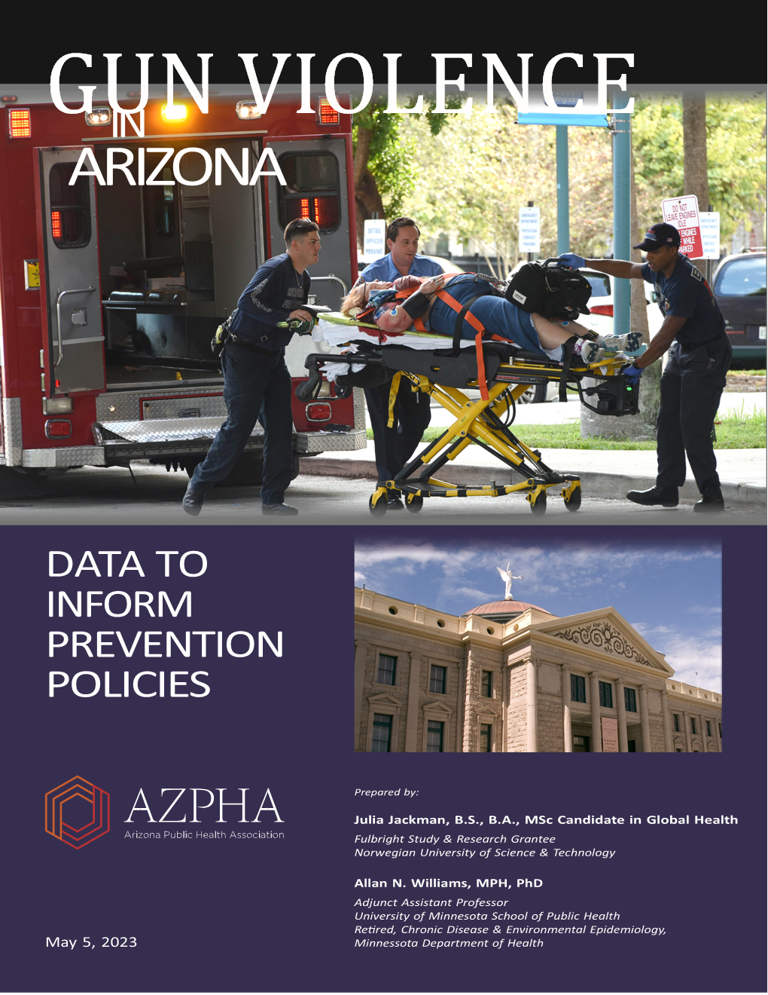
Download the Report
Firearm Violence in Arizona: Data to Support Prevention Policies
Notes:
Good morning, everyone. I want to start by expressing our great appreciation to the AZPHA for supporting this important initiative that documents gun violence in AZ and hopefully will eventually lead to some desperately needed and evidence-backed changes to Arizona’s seriously-lacking gun laws.

Slide 3
Percent of Firearm Deaths by Intent, Arizona, 1999-2020
Notes:
The great majority of gun deaths are due to suicides, and unless it involves someone famous or there’s a murder-suicide, these rarely get reported by the media.
Almost 2/3rds of firearm deaths are due to suicides in AZ (59% US); this is one of the findings that surprised me most
This chart (based on death certif data) doesn’t break out mass and school shootings, but they comprised <3% of US homicides in 2020.

Slide 4
Total Firearm Deaths by Gender, AZ, 1999-2020

Slide 5
Numbers & Rates of Total Firearm Deaths per 100,000 by County, 1999-2020
Notes:
Among AZ counties, we see a 3-fold range
Many of the 95% CIs overlap, meaning that the rates are not statistically different
The six highest counties significantly higher than state average

Slide 6
Age-Adjusted Rates & Trends, Total Firearm Mortality
US Annual percent change = 3.44%, p <0.001
Notes:
AZ 1999-2014 = -1.29 (p < 0.001);
AZ: 2014-2020 = 2.87 (p < 0.019); with 2021 data, APC = 3.5%
US: 1999-2013 (p = 0.917);
2013-2020 = 3.44 (p < 0.001); with 2021 data, APC = 4.5%, p < 0.001
2020->2021: AZ 9.8% increase; US 7.7% increase; both stat sig; AZ increase in deaths evenly split between suicide & homicide
All but 5 states saw increases in 2021, ranging from 0.1% to 43%

Slide 7
Trends – Three Leading Causes of Death, Age 1-19, Arizona
Notes:
Fig. 19 in the report shows the trends for the 7 leading causes, here just the top 3.
MVC have led firearm deaths and opioid overdose deaths over past two decades, but changed in 2020
Next slide AZ vs US

Slide 8
Three Leading Causes of Death in 2020, Age 1-19, AZ vs US
Notes:
AZ Drug Overdose/Poisoning rate highest of the 29 states with reliable data in 2020 (3.2-fold higher than US)
In 2021, despite drug overdose decline (5.8), AZ still had highest rate of 30 states (2.3-fold higher than US)
AZ Firearm, ranks 23rd among states in 2020.
AZ MVC, ranks 13th among states in 2020.
In 2021, Firearm deaths still the leading cause in the US, and became 2nd leading cause in AZ (due to significant decline in drug overdose/poisoning and increase in Firearm

Slide 9
Estimated Lifetime Risk of Death by Firearm (Sehgal, 2020)
Notes:
Graph only showing every other state due to size constraints

Slide 10
Firearm Suicides

Slide 11
Rates & Trends of Firearm Suicides, AZ vs US
AZ Annual percent change = 1.27%, p <0.001
US Annual percent change = 1.71%, p < 0.001
Notes:
AZ Suicides: 1999-2007 APC = -0.84 (p < 0.24); 2007-2020 APC = 1.27 (p < 0.001)
US Suicides: 1999-2006 APC = -0.91 (p = 0.013); 2006-2020 APC = 1.71 (p < 0.001)
2020->2021: AZ 5.9 % increase (NS); US 8.4% increase; (Sig.)
Since 2008, AZ rates rising somewhat faster in females (1.6%/yr) than males (1.25%/yr)

Slide 12
Firearm Suicide Rates by NH-Race, Ethnicity & Gender, Arizona 1999-2020
Notes:
We found that rates differ by race, ethnicity, and gender
Rate is more than twice as high among Whites than any other category
6-fold higher among males than females

Slide 13
Rates of Firearm Suicide by Age, Arizona, 1999-2020
Notes:
Male rates greatly exceed female rates at every age bracket (overall, 6-fold higher)
Female rates peak at 55-59, then decline
Male rates continue to increase with the highest rates in the oldest age categories
At 85+, rates are 24-fold higher among males than females
Same general pattern for suicides (by all means)
Percent of overall suicides involving a firearm increases with age: overall = 58%, 75-84 = 80%
Risk factors reported in Lit: physical illness & disability (eg cancer, dementia, stroke), loss of control, losing a spouse, bereavement, depression, living alone, social isolation, substance abuse, PTSD, among other factors

Slide 14
Urban-Rural Rates of Firearm Suicide, Arizona, 1999-2020
Rate difference is statistically significant, p <0.05
Notes:
50% higher rate in the more rural areas compared to the more urban areas
Fig 28 breaks this down into 6 urban-rural categories
Statistically significant difference in rates
And we’ll see that urban-rural diff at the county level….

Slide 15
Firearm Suicide Rates by County, 1999-2020
Notes:
Overlapping CIs among top 4, so those rates are not significantly different
Fig 28 breaks this down into 6 urban-rural categories
4-fold variation in rates

Slide 16
Firearm Suicide Rates by Age, 1999-2020, AZ vs US
Notes:
A few slides back, we looked at rates by age and gender, here we’re again looking at age, but comparing AZ to the US
AZ has significantly higher rate at every age category than the US (5-14 not sig diff). Overall, a 56% higher age-adj rate (9.70 vs 6.22)

Slide 17
Notes:
R² indicates that 79% of the variability in firearm suicide rates is explained by the percent of household gun ownership.

Slide 18
Firearm Homicides

Slide 19
Rates & Trends of Firearm Homicides, AZ vs US
Notes:
AZ Homicides: following a decade long decline from 2005-2014 APC = -6.7 (p = 0.001); rates began to rise after 2014 at 7.1%/yr , p=0.013
US Homicides: steady until 2014, then also started to rise by 7.5%/year (p < 0.001)
2020->2021: AZ 12.6 % increase (NS); US 8.1% increase; (Sig.)

Slide 20
Firearm Homicide Rates by NH-Race, Ethnicity & Gender, Arizona 1999-2020
Notes:
Except for Blacks, all rates are significantly higher than US rates
Black rates >twice as high as any other racial category
Age-adj rates 4.8-folder higher in males than females

Slide 21
Firearm Homicide Rates by Age, AZ, 1999-2020
Notes:
Except for the youngest & oldest categories, male rates higher than female rates.

Slide 22
Urban-Rural Rates of Firearm Homicides, AZ, 1999-2020
Rate difference is statistically significant, p < 0.05
Notes:
Here, we see an urban-rural difference, but opposite the pattern with firearm suicides
Rates significantly higher in the Metro than in non-metro areas.
And we’ll see urban-rural difference reflected at the county level…..

Slide 23
Firearm Homicide Rates by County, 1999-2020
*Unreliable Rates; Greenlee data suppressed
Notes:
A lot of the conf. intervals overlap, indicating that statistically-speaking, there’s less variation than it appears.

Slide 24
Firearm Homicide Rates, AZ vs US
Rates significantly higher in AZ
Notes:
AZ rate for 85+ is unreliable (14 deaths)
AZ rate higher at every age category
Overall age-adjusted rate in AZ is 19% higher than US (4.9 vs 4.1)

Slide 25
Mass Shootings

Slide 26
Mass Shooting Events, Deaths & Injuries, Arizona
Notes:
2014-2022, 47 mass shootings, causing 78 deaths and 182 injuries.
78 deaths is 1.0% of the total firearm deaths in AZ during that same time period.

Slide 27
Mass Shootings by Location, AZ 2006-2022
Notes:
Where do they occur?

Slide 28
Weapons Used in Mass Shootings, US 2006-2022
Notes:
What weapons are used? (Fig. 81).

Slide 29
School Shootings

Slide 30
Deaths, Injuries, & Incidents of School Shootings in the US, 1970-2022 (https://k12ssdb.org)
Notes:
Incidents: updated 2022 data shows 303 incidents (graph shows 269).
Wounded & killed: updated 2022 data shows 332 (graph shows total of 252).
83 incidents so far in 2023, 66 wounded or killed

Slide 31
Who Are the School Shooters in the US?
Notes:
Fig. 74, 1970-Nov2022

Slide 32
School Shooting Incidents in Arizona by Decade, 1970-Nov. 2022
* First three years of the decade
Notes:
2020-2022 = 3 yrs, more school shooting incidents in the 1st three years than in the previous decade.

Slide 33
Types of Firearm Used in AZ School Shootings
Notes:
Fig. 71

Slide 34
Firearm Ownership

Slide 35
Estimated Proportion of Adults Who Live in a Household With a Firearm, AZ, 1980-2016
Notes:
RAND estimates combined direct estimates from 51 surveys along with multiple proxy measures such as background checks.
AZ household ownership peaked in 1989 at 62%, then declined by 3.9%/yr until leveling off after 2001.
Ave around 37% 2014-16
AZ exceeded national rate by 4 – 14% (based on 3-yr rolling averages)
A 2021 national survey estimated that 32% of adults (1.8 million) owned a gun in AZ, comparable to the % nationally.

Slide 36
Estimated Annual Firearm Sales, AZ, 2000-2021
104% increase over 2019
(296,000 to 603,000)
Notes:
Sales in the US increased by 4.5%/yr until 2019; 2020 sales increased by 64% over 2019 reaching 21 million.

Slide 37
Unintentional Shootings
Notes:
There’s a limited amount we can say about unintentional shootings in AZ because for almost every year the rates are either suppressed (<10) or unreliable (<20).
In addition to the small numbers, death certificate data can represent either an undercount or an overcount.

Slide 38
Unintentional Firearm Mortality Rates & Trend, Children Aged 1-4, US
Notes:
One trend based on US data I thought was important to look at.
A paper published in 2021 that showed a 4.9% APC from 1999-2018.

Slide 39
Unintentional Firearm Deaths by Circumstance, Arizona & 24 States with Available Data, 2015-2019
Circumstance | Arizona |  |  | 24 States
 | Deaths | Percent |  | Deaths | Percent
Unintentionally pulled trigger | 31 | 43.1% |  | 220 | 23.9%
Playing with gun | 25 | 34.7% |  | 340 | 36.9%
Other context of injury | 24 | 33.3% |  | 251 | 27.2%
Thought gun was unloaded-other | 21 | 29.2% |  | 129 | 14.0%
Other mechanism of injury | 19 | 26.4% |  | 197 | 21.4%
Thought unloaded magazine disengaged | 14 | 19.4% |  | 67 | 7.3%
Cleaning gun | 13 | 18.1% |  | 90 | 9.8%
Showing gun to others | 9 | 12.5% |  | 111 | 12.0%
Gun fired loading/unloading | 8 | 11.1% |  | 47 | 5.1%
Dropped gun | 4 | 5.6% |  | 52 | 5.6%
Hunting | 2 | 2.8% |  | 68 | 7.4%
Target shooting | 2 | 2.8% |  | 36 | 3.9%
Gun defect or malfunction | 2 | 2.8% |  | 35 | 3.8%
Gun mistaken for toy | 2 | 2.8% |  | 27 | 2.9%
Thought safety was engaged | 0 | 0.0% |  | 18 | 2.0%
Notes:
Table 17. Top two: Unintentionally pulled trigger or playing with gun (78% in AZ, 61% in US)

Slide 40
Unintentional Firearm Mortality Rates 1999-2020 vs Household Gun Ownership 1999-2016, 47 States
Notes:
R² = 0.527, so even with all the noise from under and overcounts, we still see a sig. correlation.

Slide 41
Police Shootings (AKA Law Enforcement Intervention)

Slide 42
Rates of Police Shootings for 20 States with Reliable Data from NVDRS, 2015-2019
Notes:
AZ rate remained the same if included 2020 data; other states same or little change
In an updated analysis 2016-2020 w/30 states, AZ still ranked 4th highest at 0.67.

Slide 43
Rates of Fatal Police Shootings, 10 Largest US Cities, 2015-2021
Sources: MPV; FBI Crime Data Explorer
Notes:
Used Mapping Police Violence; but same rankings if used Wash Post database or Fatal Encounters.
These are the fatal shootings by the city police dept.
Same proportion of victims armed with a weapon or vehicle in PHX vs other 9 cities (83%).
In a stepwise multiple regression analysis that included variables of race, ethnicity, and violent crime, only Ameri. Ind race was signif, but could not acct for >rate.

Slide 44
Rates of Fatal Police Shootings by Three City Police Departments in AZ, 2015-2021
Notes:
We looked at the next two largest cities in AZ to see how they compared to PHX

Slide 45
Trends in Police Shootings, AZ vs US, 2000-2021 (Source: FatalEncounters.org)
AZ Annual percent change = 4.0%, p < 0.001
Notes:
Fatal Encounters (longer time frame)
Rates have been significantly increasing in both AZ and the US

Slide 46
Gun Law Status & Impacts

Slide 47
Giffords Ratings of State Gun Laws from Strongest (A) to Weakest (F), 2021 (Giffords Law Center)
Notes:
In 2021, Giffords ranked CA 1st in the nation on the strength of its gun laws, while Arkansas ranked 50th.
AZ has consistently ranked near the bottom, ranging from the current 42nd (2021) to 50th.
More people reside in F-rated states (110m) than in A-rated states (99m), despite CA, NY, IL.

Slide 48
Everytown Research State
Gun Law Rating Scores Based
On 50 Key Gun Policies
Arizona
Notes:
Chart only shows every other state name in this slide, but Figure 88 in the report shows all the state labels.
Mississippi is at the bottom.

Slide 49
Overall Firearm Mortality Rates Among Everytown's 14 States with the Weakest Gun Laws vs. 8 States with the Strongest Gun Laws by Gender, Race/Ethnicity, 1999-2020
Notes:
Here’s a similar analysis based on Everytown’s ”National Leaders” (same as Giffords A-states) vs “National Failures”.

Slide 50
Policy Options

Slide 51
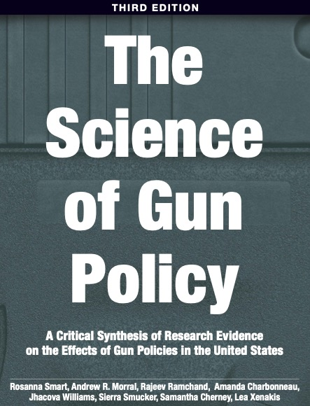
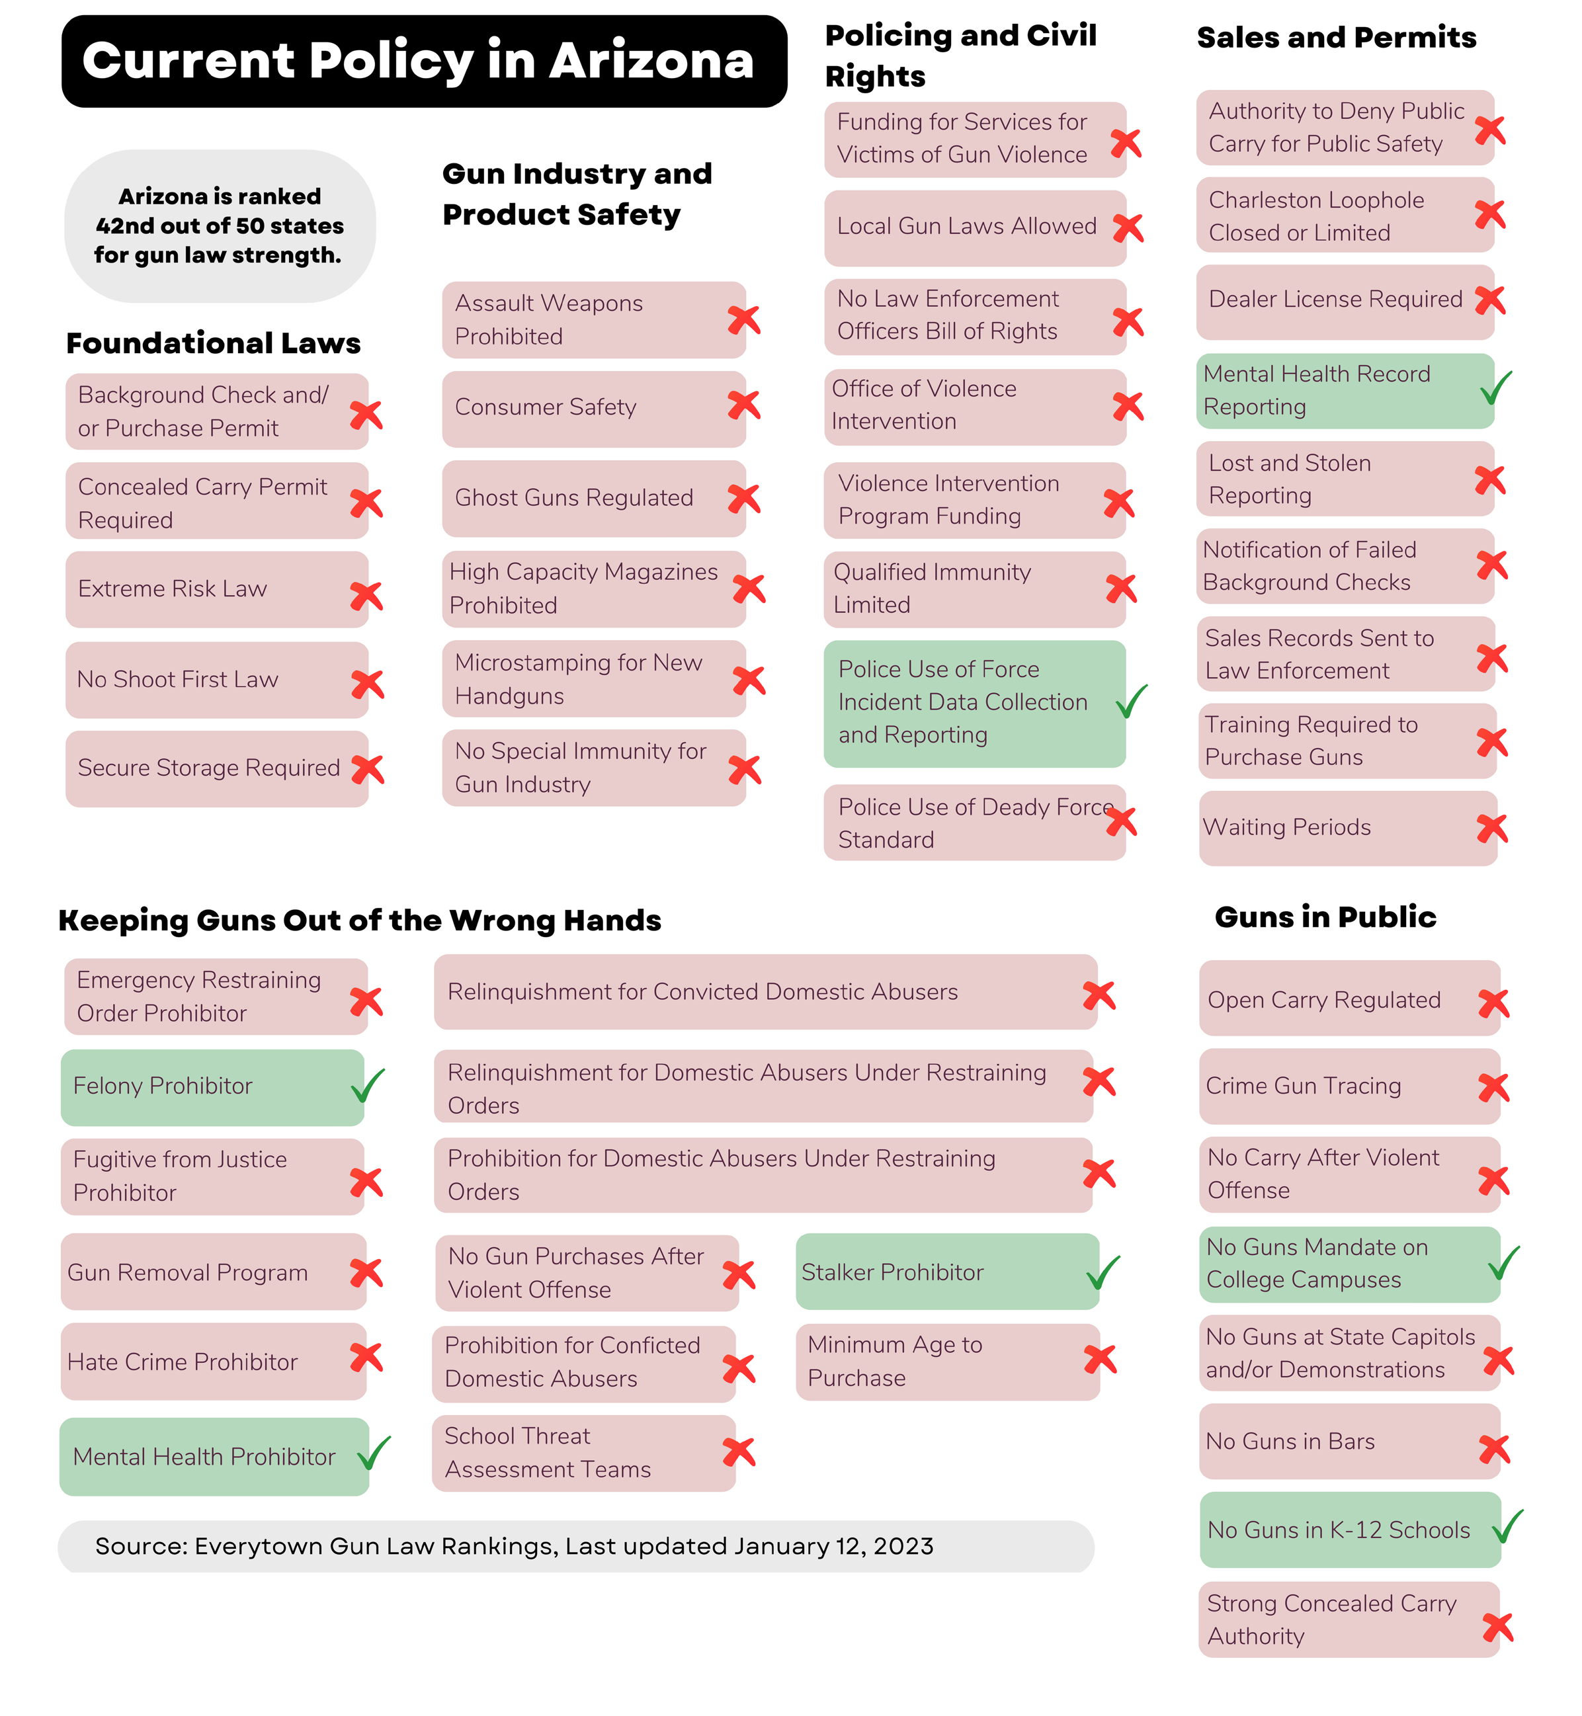
https://www.rand.org/pubs/research_reports/RRA243-4.html
Notes:
Plenty of available policy options (Everytown)
…and a comprehensive 400+ page review of research on the effectiveness of gun policies (RAND, 2023)
In a national poll conducted for CNN last summer, 66% favored stricter gun laws, the same as in 1989.
Support varied by race (Blacks^), gender (female^), education, age (65+^), political party (92% leaning Democratic, and 38% leaning Republican.

Slide 52
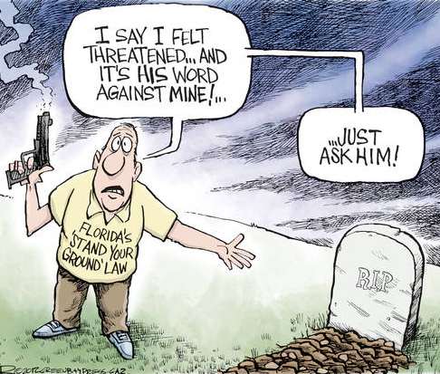
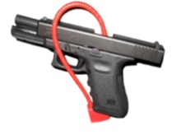
Repeal stand-your-ground (“shoot first”) laws. Stand-your-ground laws: allow individuals to legally shoot and kill someone if they are intimidated, even if they could retreat and if they started the confrontation
Pass Child Access Prevention (CAP) and safe storage laws.
CAP laws: make adults criminally liable for negligently storing or recklessly providing children with access to firearms
Safe storage laws: require guns to be stored locked and unloaded when a child (or other person prevented from having a gun) is in a home
Pass requirements for a background check and/or permit to purchase a firearm. Background checks laws: require a background check for handgun purchases at the point of sale and/or require a background check for a permit to purchase a handgun. These laws are very popular (93% in support of requiring background checks on all sales).
Notes:
CAP/Safe Storage: effective at reducing both unintentional and suicide firearm deaths
Stand-your-ground: these laws have been shown to increase homicides
Background Checks: While dealers have to do a background check, private sales (gun shows) don’t require background checks. Background checks reduce homicides, suicides, gun trafficking.

Slide 53
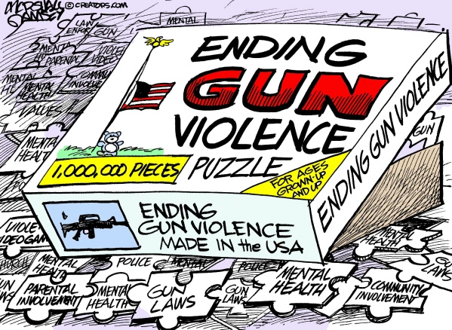
Pass an Extreme Risk (Red Flag) law Extreme Risk Laws: allow immediate family members and law enforcement to contact local authorities to petition a civil court for an extreme risk protection order (ERPO) to temporarily restrict access to guns for someone who is seriously at-risk of harming themselves or others.
Pass permit requirements for anybody carrying a concealed firearm in public
Concealed carry permitting: these laws require individuals to have a permit to carry a loaded and concealed handgun in public. Arizona is a “shall-issue” state, meaning that anybody who meets state requirements to own a gun can be issued a concealed carry permit.
Notes:
In 2010, AZ repealed its law that required a permit and training to carry a concealed firearm. AZ, even though anybody can carry a concealed weapon if they can legally own a gun, permits are still issued for reciprocity with other states. Still a shall-issue state.
Red flag laws ensure due process. Many of you may have seen the news story a week ago about the father in Chandler who shot the mother of their 4 kids in front of them, following a history of escalating violence. Would a Red Flag law have prevented this?
Many polls have shown strong support for stricter gun laws.
In a national poll conducted for CNN last summer, 66% favored stricter gun laws, the same as in 1989.
Support varied by race (Blacks^), gender (female^), education, age (65+^), political party (92% leaning Democratic, and 38% leaning Republican. Republicans were the only demographic for which a majority opposed stricter gun laws.

Slide 54
Download the Report
Firearm Violence in Arizona: Data to Support Prevention Policies
Notes:
Good morning, everyone. I want to start by expressing our great appreciation to the AZPHA for supporting this important initiative that documents gun violence in AZ and hopefully will eventually lead to some desperately needed and evidence-backed changes to Arizona’s seriously-lacking gun laws.

